Slide 1
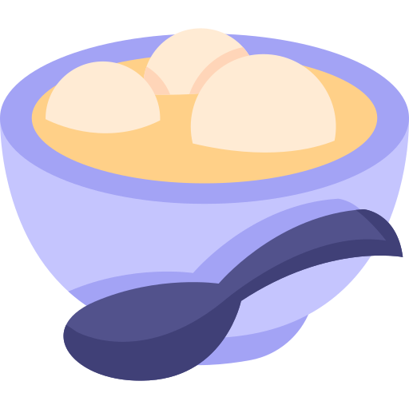
Tangyuan
湯圓

Slide 2

What is Tangyuan?

Slide 3
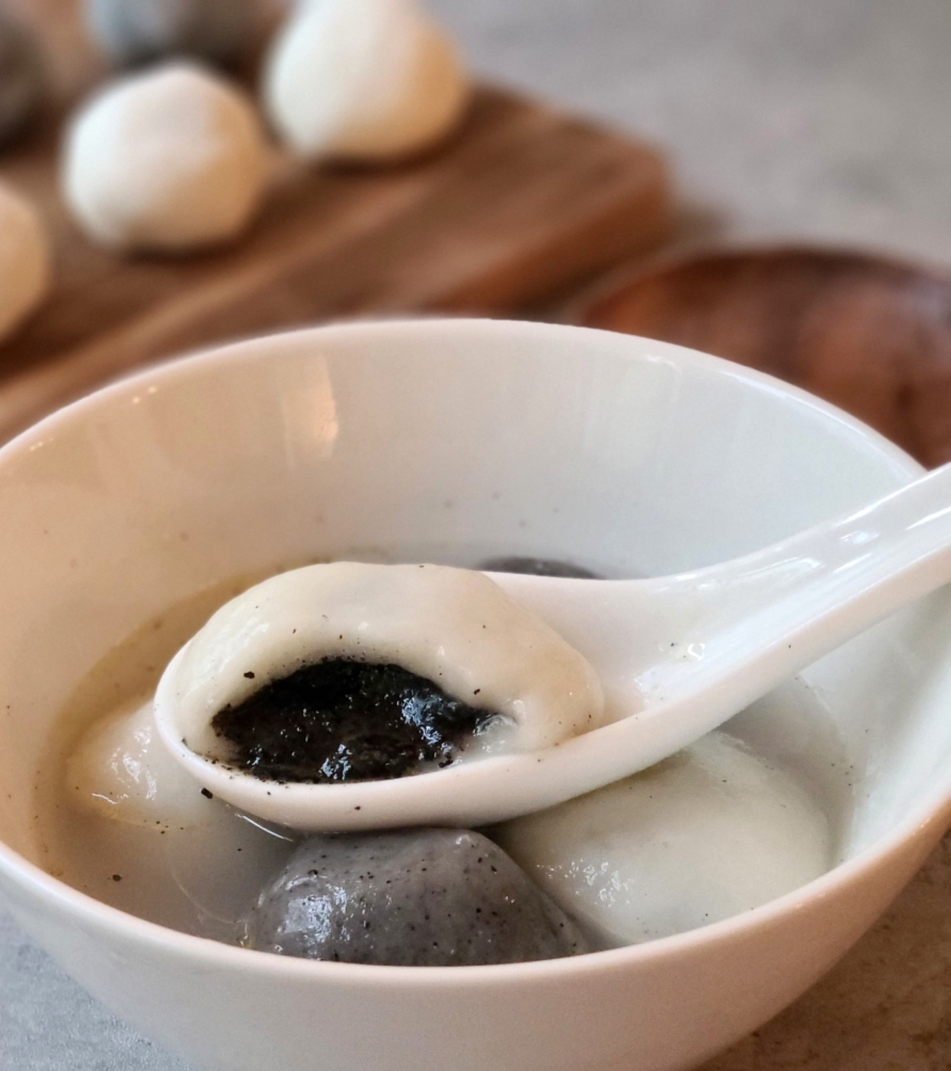
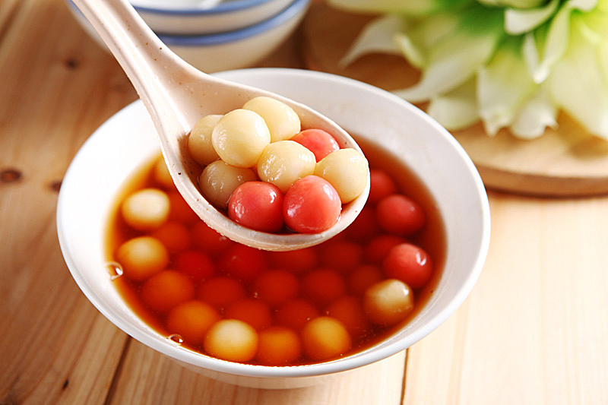
Notes:
s a traditional Chinese dessert made of glutinous rice shaped into a ball that is served in a hot broth or syrup. They come in varying sizes, anything between a marble to a ping pong ball,^{[1]} and are sometimes stuffed with filling. Tangyuan is traditionally eaten during the Lantern Festival,^{[2]} but because its name is a homophone for union (traditional Chinese: 團圓; simplified Chinese: 团圆; pinyin: tuányuán) and symbolizes togetherness and completeness, this dish is also served at weddings, family reunions, Chinese New Year, and the Dōngzhì (winter solstice) festival.^{[3]}

Slide 4
When will we eat Tangyuan?

Slide 5

Winter solstice

Slide 6
Why?

Slide 7

Winter solstice
Tangyuan ≒ Reunion 團圓 tuán yuán

Slide 8
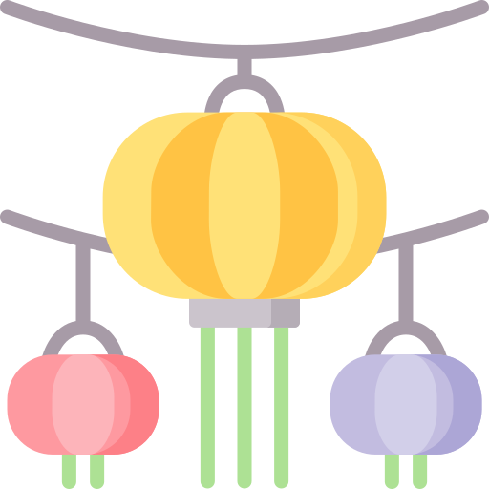
Lantern festival

Slide 9
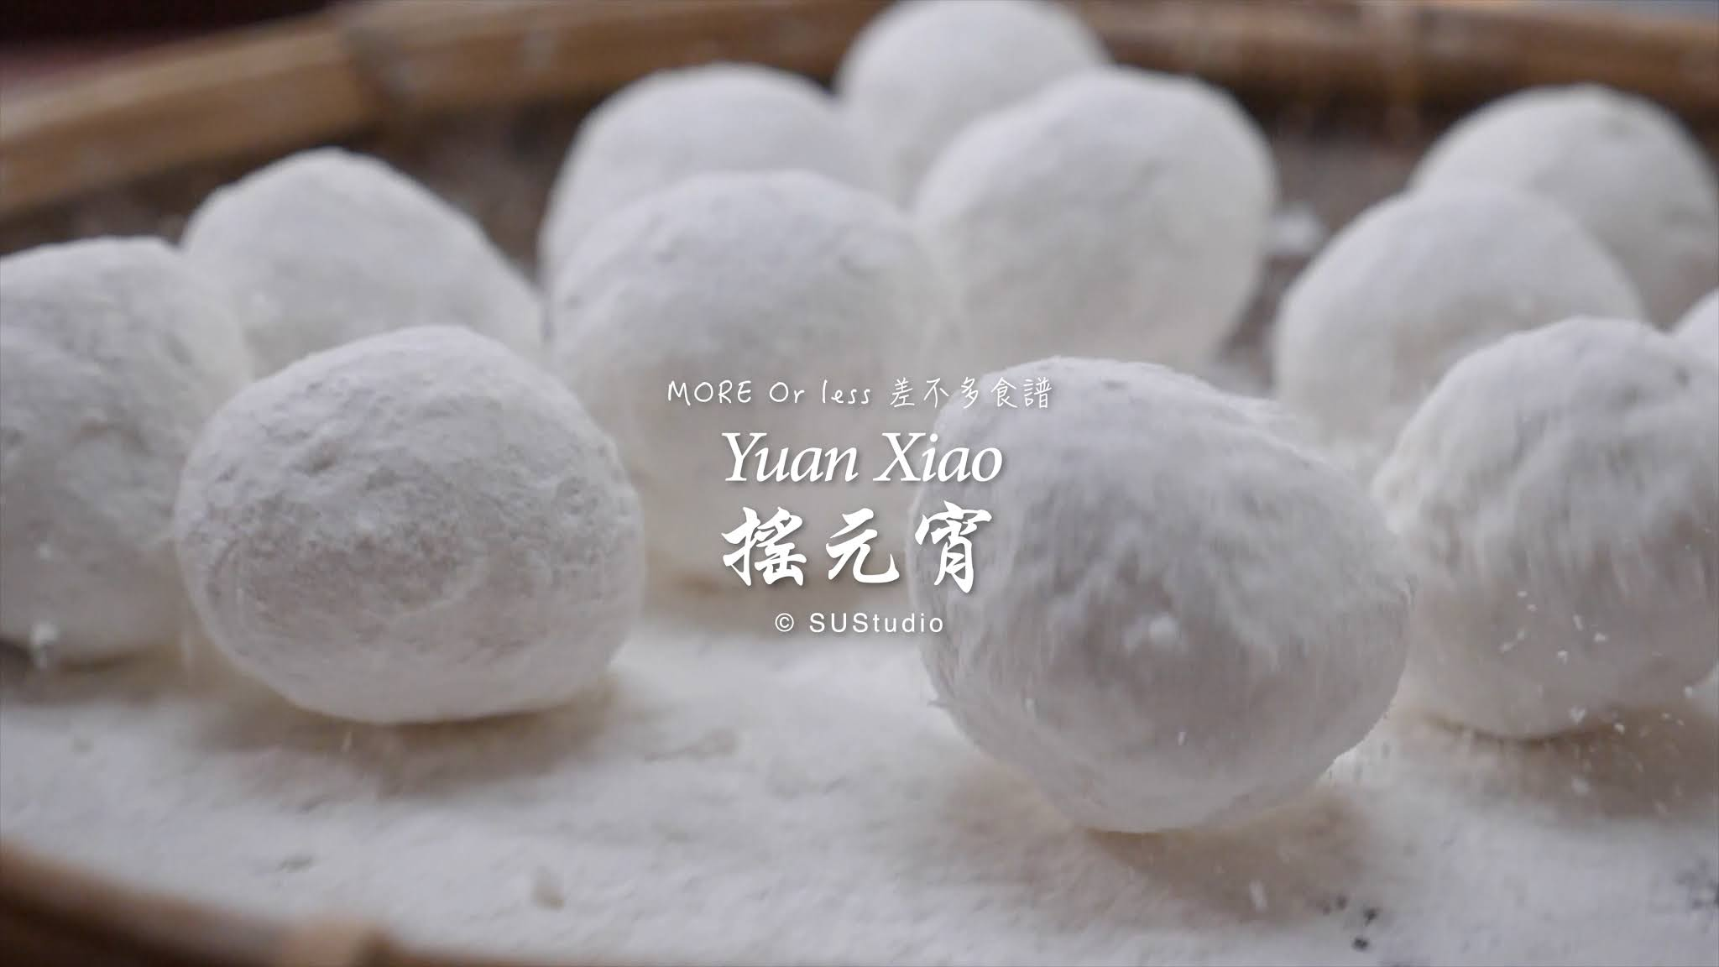

Slide 10
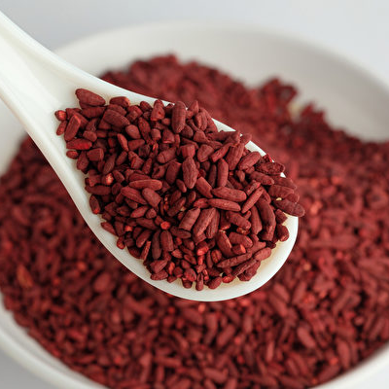
Original
Red yeast rice
Matcha

Slide 11
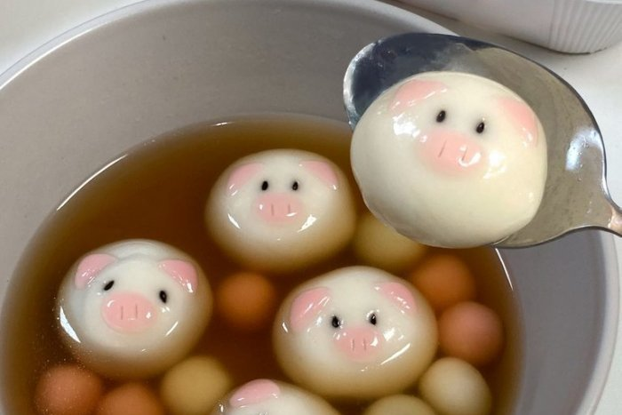

Slide 12
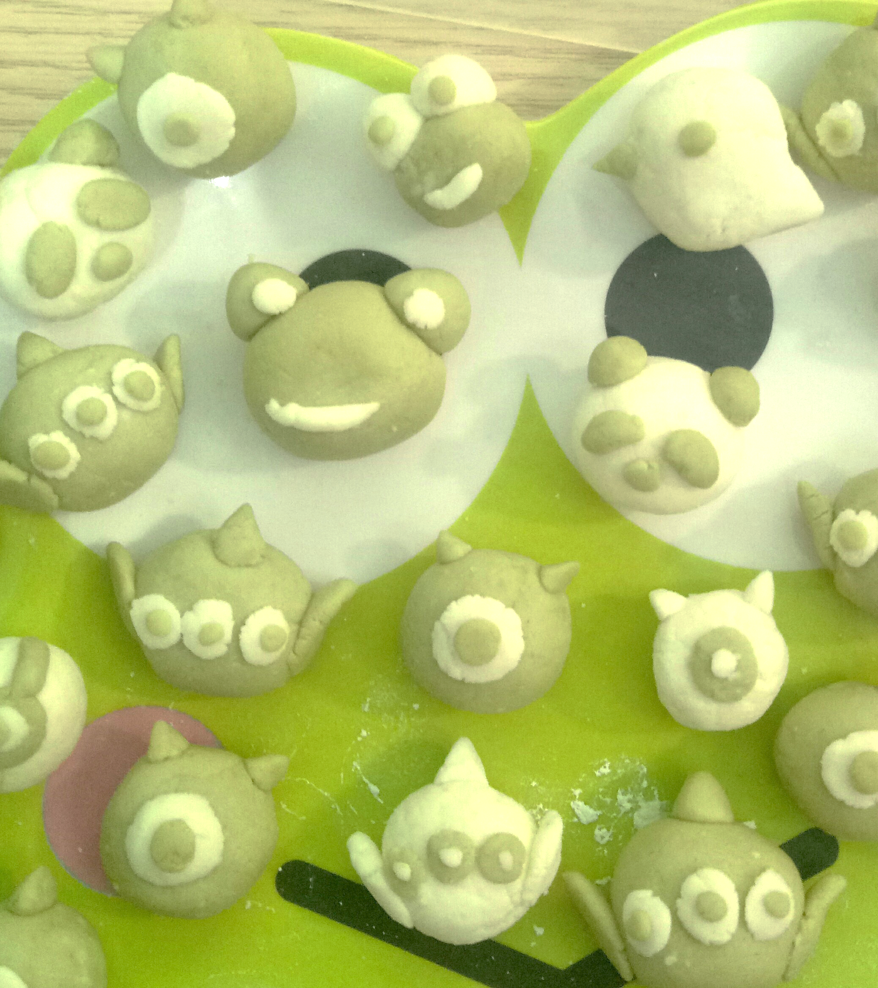
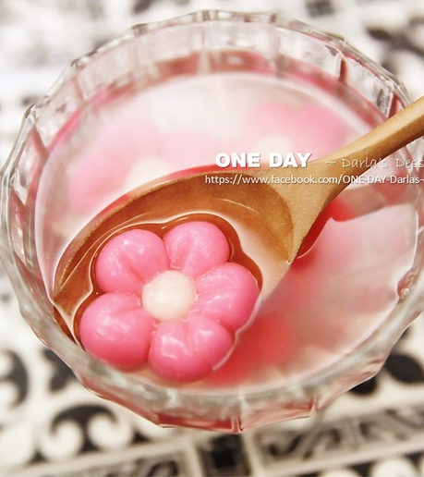

Slide 13
Let’s start to make Tangyuan with your own style!

